Slide 1
Using Latin Treebank Data to Analyze Authorial Stylistics
Brian Clark
Advisor: Professor J. Matthew Harrington

Slide 2
Book 13 of Ovid’s Metamorphoses
Contest for the arms of Achilles
Fate of the house of Priam
Start of the “Little Aeneid”
Polyphemus, Galatea, and Acis

Slide 3
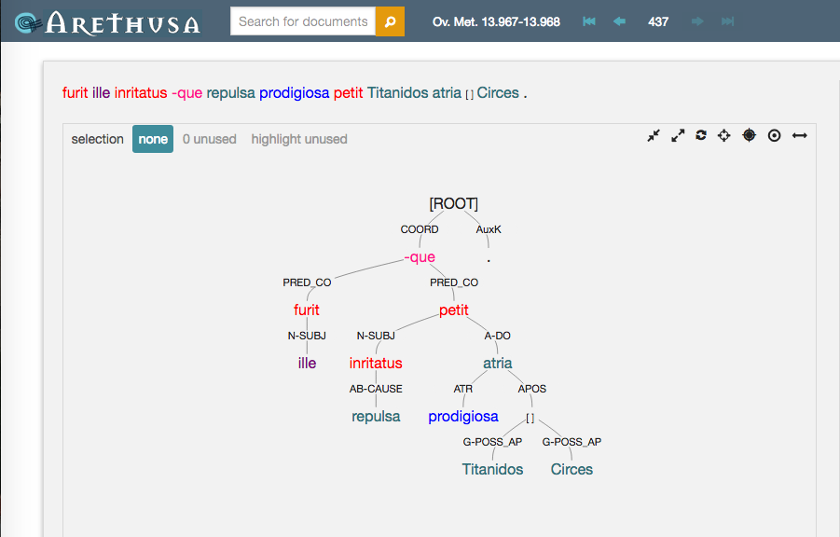
Treebanking

Slide 4
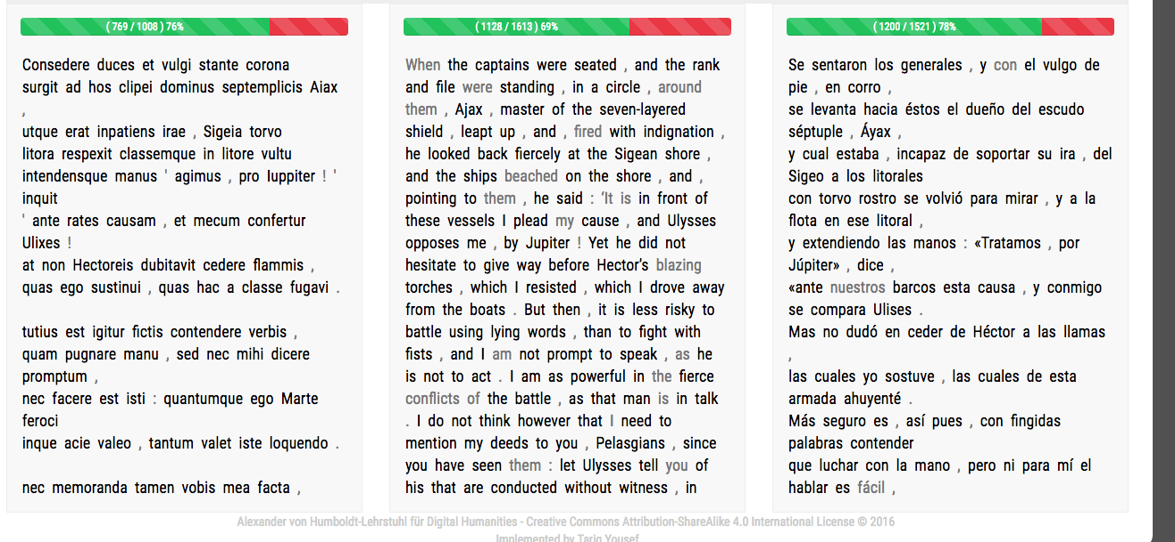
Tri-lingual Alignment

Slide 5
Analysis & Method

Slide 6
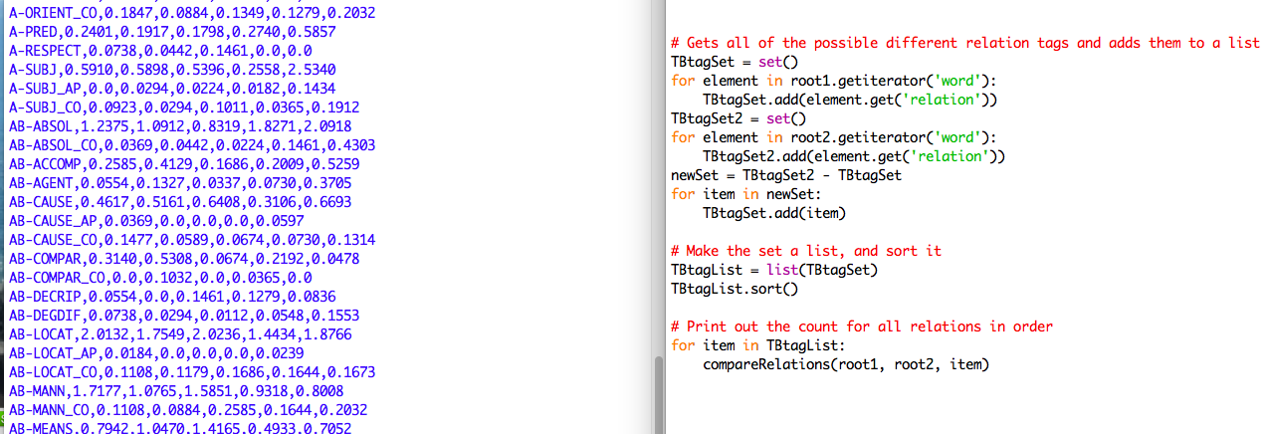
Every Unique Tag

Slide 7
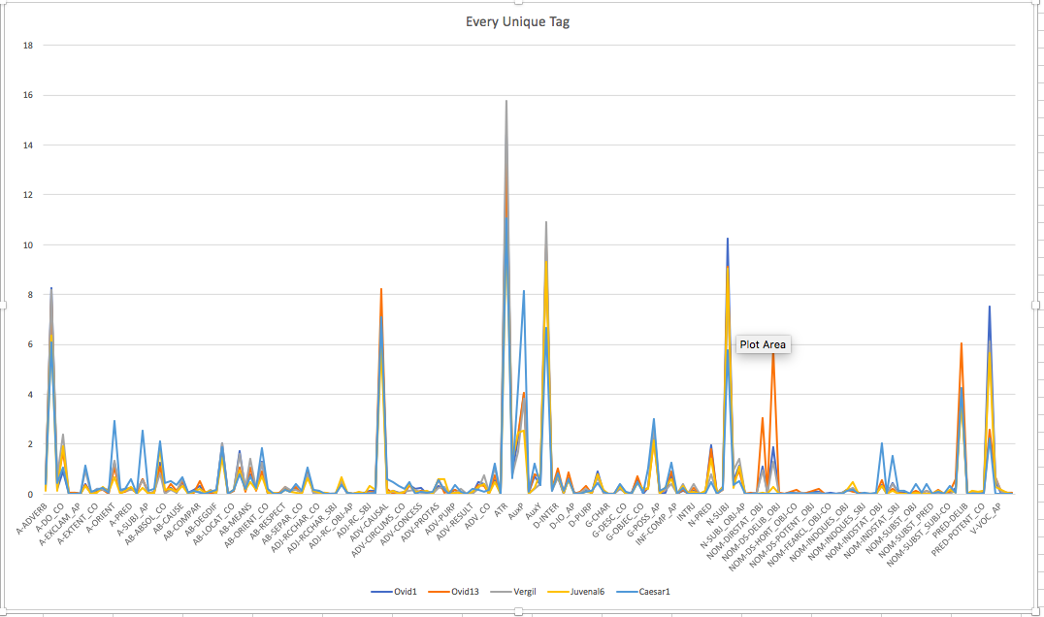

Slide 8
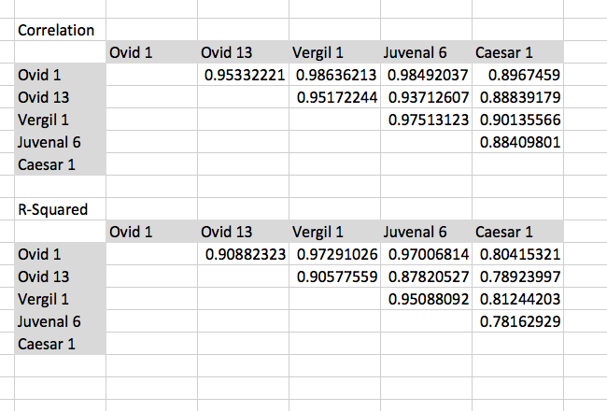
Every Unique Tag

Slide 9
Tags that Modify Ablative Absolutes

Slide 10
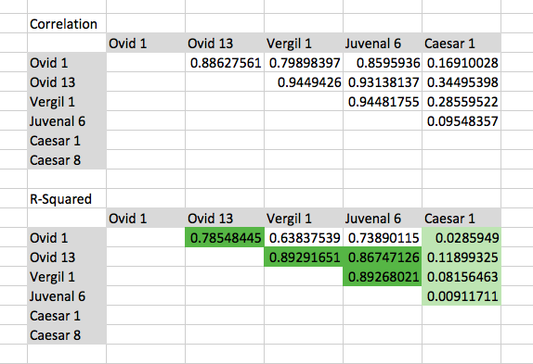
Tags that Modify Ablative Absolutes

Slide 11
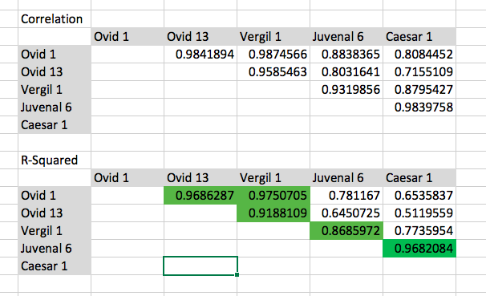
Conjunction words

Slide 12
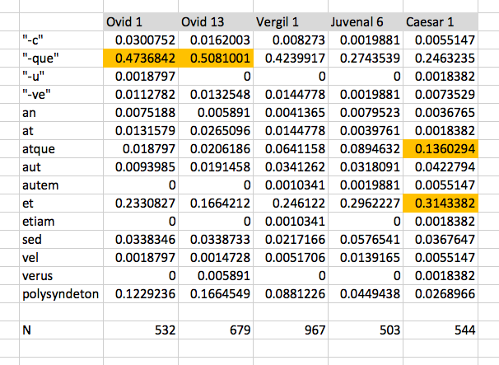
Conjunction Words

Slide 13
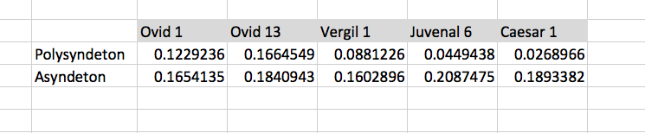
Conjunctions

Slide 14
Future Areas of Study
More treebanks!
Work with different authors, genres, and time periods
Continue to look at what certain constructions modify
And improve code
Ultimately design tests around several different features

Slide 15
Demonstration of Teaching Tool
Project and code can be found on:
https://github.com/brclar15/ovidTreebank

